Slide 1


Wet Contract Drafting in a Smart Contract World
an exploration & primer
Gabriel Shapiro – ZeroLaw

Slide 2
Contents
Wet Contracts vs. Smart Contracts
Approaches to Smart Contracts
Smart Contract Risks / Wet Contract Solutions
A. Drafting Cryptocurrency Transfer Provisions
B. Drafting for Qualified Code Deference
Objections & Answers

Slide 3
Wet Contracts vs. Smart Contracts

Slide 4

Legal Contracts
Methods of Creating/Expressing Legal Contracts:
natural language
=> written contracts
=> oral contracts
course of conduct (=> implied-in-fact contracts)
fairness principles (=> quasi-contracts/implied-in-law contracts)

Slide 5
Legal Contracts
Definitions
“an agreement between private parties creating mutual obligations enforceable by law”
Required Elements
mutual assent (expressed by valid offer & acceptance)
adequate consideration
capacity
legality
Enforcement
traditional legal process backed by (threat of) State coercion
breaching party pays expectation damages
sometimes, specific performance is ordered
limitations (no enforcement of illegal subject matter, or legal subject matter done in an illegal way (unconscionability, etc.))
“promises that the law will enforce”

Slide 6
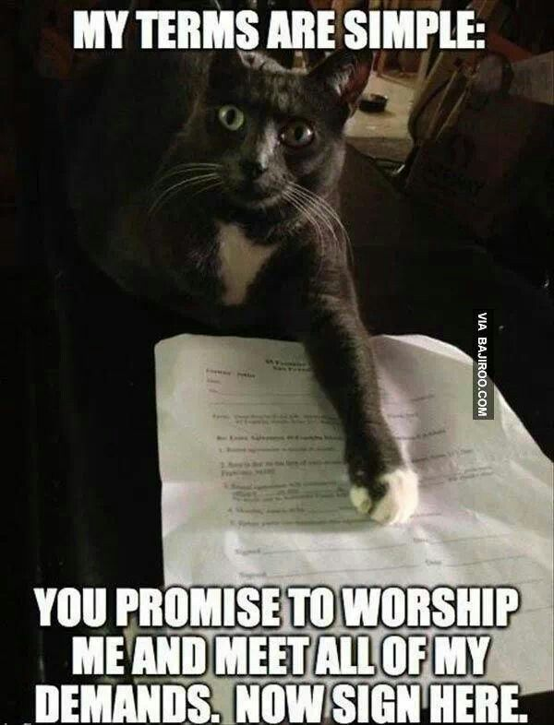
Wet Contracts
legal contracts that are written in a version of natural-language & signed by the parties
Language = “Legalese”—an annoying variant of English ☺
long history; what most people think of from the word “contract”
some legal contracts must be “wet” to be enforceable (Statute of Frauds)
can be digital (a PDF of the document) and can be signed electronically ([ESIGN act], etc.)

Slide 7
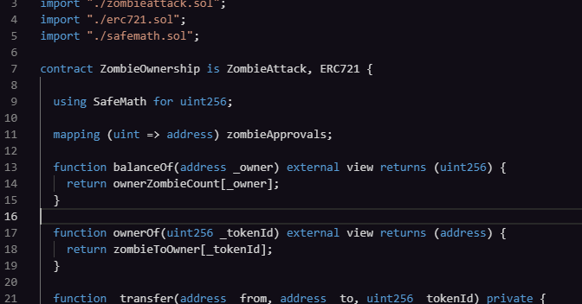
Smart Contracts
meaning of “smart contract” : not clear or consistent
can just be some code, but can also have legal meaning
can be (but is not necessarily) a written, implied-in-fact or implied-in-law legal contract
can be (but is not necessarily) deployed on a blockchain
can be (but is not necessarily) an aid to performing a written or oral legal contract
when deployed on a blockchain, a smart contract is also (incidentally or purposefully) an address/wallet that can send and receive cryptocurrency
always enforced by code; sometimes enforceable by law; sometimes unenforceable under law

Slide 8
Smart Contracts
Neutral(-ish) general definition of “smart contract”:
algorithms written in source code and deployed to a distributed network so that they remain persistent and can be triggered and/or verified by network participants
FOR THIS TALK: “SMART CONTRACT” =
code deployed to an Ethereum blockchain address (so also is an Ethereum address/wallet that can send and receive ETH, ERC-20 Tokens, etc.)
immutable
public
NOT a legal contract (why? stay tuned…)

Slide 9
Approaches to Smart Contracts
Notes:
Consider talking about:
Energy use

Slide 10
Absolute Code Deference “Code is Law”
No binding natural language description; outcome of running code is (intended to be) legally determinative, final and binding
If you can’t read code, you don’t know what you’re agreeing to
Example - TheDAO “terms of service”:
“The terms of The DAO Creation are set forth in the smart contract code existing on the Ethereum blockchain at 0xbb9bc244d798123fde783fcc1c72d3bb8c189413. Nothing in this explanation of terms or in any other document or communication may modify or add any additional obligations or guarantees beyond those set forth in The DAO’s code. Any and all explanatory terms or descriptions are merely offered for educational purposes…”

Slide 11
Absolute Code Deference “Code is Law”
Problems
A contract is a “meeting of minds”; it is nice to express or represent what the minds met on (as precisely as possible).
This is why people prefer wet contracts to contracts implied-in-fact.
Code is mostly designed to do stuff, not to represent stuff
At best, code may evidence contractual “terms”—it doesn’t represent them.
Code by itself != offer/acceptance/consideration.
At best, interaction with code may imply offer/acceptance/consideration.

Slide 12
Absolute Code Deference “Code is Law”
Better idea—Have a WET CONTRACT that says the following:
“By virtue of voluntarily sending or receiving any message or tokens to or from the smart contract existing on the Ethereum blockchain at
0xbb9bc244d798123fde783fcc1c72d3bb8c189413
(“The DAO Contract”), you will be deemed to represent, warrant, acknowledge and agree as follows, with legally binding effect: “

Slide 13
Absolute Code Deference “Code is Law”
Better idea—Have a WET CONTRACT that says the following:
“1. You have full legal capacity, power and authority to enter into and perform this agreement and any and all transactions you undertake with The DAO Contract. This agreement constitutes your valid and binding obligation, enforceable in accordance with its terms.”

Slide 14
Absolute Code Deference “Code is Law”
Better idea—Have a WET CONTRACT that says the following:
“2. The results of operation of The DAO Contract shall be determinative of the rights and obligations of, and shall be final, binding upon and non-appealable by, you and all other persons directly or indirectly transacting therewith, including, without limitation, with respect to the allocation, retention and distribution of any profit interests, profits, voting rights, votes and investments of you or other persons in The DAO Contract, and you shall not dispute, contest or litigate any such results.”

Slide 15
Absolute Code Deference “Code is Law”
Better idea—Have a WET CONTRACT that says the following:
“3. In the event of any conflict or inconsistency between the results of operation of The DAO Contract and any oral or written description of The DAO Contract or other statements or information provided by any person, the results of operation of The DAO Contract shall govern and control, and you represent and warrant that you have not relied on any such description, statements or information in determining to enter into this agreement, including for purposes of claims based upon fraud or intentional misrepresentation.”

Slide 16
Absolute Code Deference “Code is Law”
Better idea—Have a WET CONTRACT that says the following:
“4. This agreement represents the entire agreement among the parties with respect to all matters relating directly or indirectly to The DAO Contract, and supersedes and prior written or oral understandings with respect to such matters. The interpretation of this agreement shall be governed by Delaware law, and any dispute regarding this agreement shall be resolved exclusively by binding mandatory confidential arbitration in accordance with the Delaware Rapid Arbitration Act.”

Slide 17
Absolute Code Deference - “Code is Law”
Pros
Eliminating natural language can reduce transaction costs associated with lawyers negotiating/drafting legalese
Cons
Ambiguous—code is better at doing things than representing things. Courts may imply terms.
Unreasonably pressures pre-deal due diligence—smart contract’s code must be perfect.
Can produce draconian results—e.g., The DAO hack if it had not been reversed.
Automating performance can reduce monitoring and enforcement costs

Slide 18
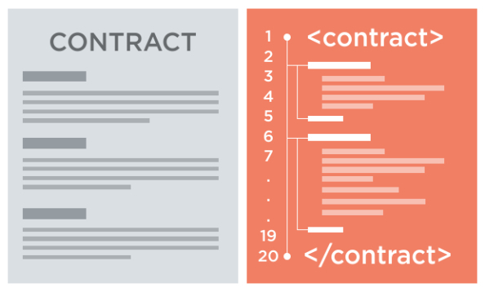
Ricardian Contracts + Smart Contracts
Ricardian Contracts - Developed by Ian Grigg in 1996 for “Ricardo,” an early payment/accounting system
= a wet contract, but:
annotated in markup language for machine-readability,
signed with private key(s)
hashed to a unique cryptographic identifier
Pre-dates blockchain smart contracts, but can be combined with them
Blockchain implementation can be as simple as hashing the natural language and/or code to the blockchain to create a record, or as complex as “Ricardian triples” that include blockchain-based smart contract functionality

Slide 19
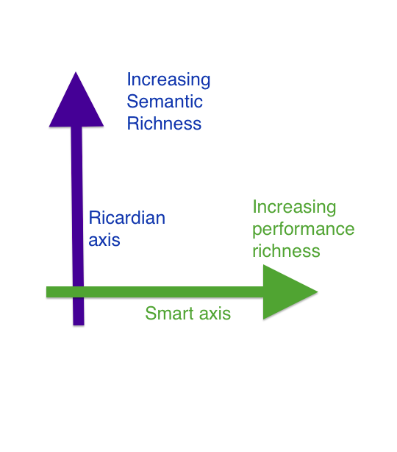
Ricardian Contracts + Smart Contracts

Slide 20
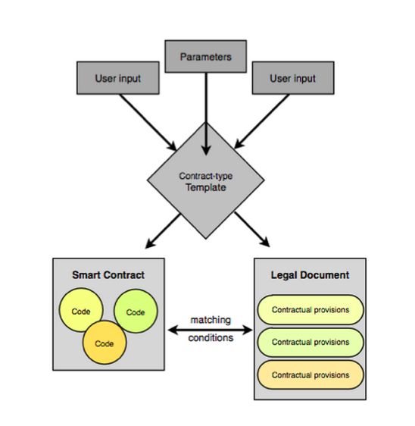
Ricardian Contracts + Smart Contracts

Slide 21
Ricardian Contracts (By Themselves)
Pros:
Preserves legacy of prose contracts
Efficient contract assembly
Efficient data analysis across groups of contracts
Cryptographic guarantees of text & signature
Contracts remain human-readable, so judge/arbitrator can adjudicate/arbitrate dispute without knowing code
Blockchain integration is possible
Cons:
No material gains in transaction finality or reduction of transaction/enforcement costs as compared to traditional wet contracts.
Efficient tracking/accounting

Slide 22
Ricardian Contracts + Smart Contracts
Pros:
Best of both worlds – prose & code
Cons:
Risk discrepancies between smart contract & wet contract; means disputes ultimately must defer to wet contract, losing many “code deference” benefits of smart contract.
Need two sets of advisors or more expensive advisors with two skill sets.
All benefits of Ricardian Contracts, many benefits of Smart Contracts

Slide 23
Qualified Code Deference
“Code is law...kinda”
Outcome of running designated code is final and binding, EXCEPT in a “Material Exception Event”—then initiate standstill and refer to natural-language backup or go to arbitration
“Material Exception Event” can be seasoned to taste

Slide 24
Qualified Code Deference – Historical Precedent - EDI
Electronic Data Interchange (EDI)
"the computer-to-computer interchange of strictly formatted ([i.e., machine-readable and typically only machine-read] messages that represent documents other than monetary instruments” (NIST – 1996)
embodied in different use-specific standards: X12, EDIFACT, ODETTE
mainly used for goods invoicing & ordering
“EDI partners would frequently enter into EDI trading agreements— traditional, semantic contracts that structured their use of EDI…This is another example of parties using a paper contract to create an “interpretive regime” to govern the particular risks of their transaction, as in Part II. In this case, an EDI trading agreement could be used to avoid adverse outcomes under UCC § 2-207. [For example,] EDI users opted to use trading agreements to preclude the possible application of buyer-favored UCC gap-fillers).”

Slide 25
Qualified Code Deference – Historical Precedent - EDI
EDI Trading Agreement - Example
“The conduct of the parties pursuant to this Agreement[…]shall, for all legal purposes, evidence a course of performance accepted by the parties in furtherance of this Agreement.”
“The parties agree not to contest the validity or enforceability of Signed Documents under the provisions of any applicable law relating to whether certain agreements are in writing and signed by the party to be bound thereby.”

Slide 26
Qualified Code Deference – for Smart Contracts
Have a short/sweet wet contract that says ‘we defer to the code, unless there is a Material Adverse Exception Event.’
“Material Adverse Exception Event”
Inspired by M&A “Material Adverse Effect” condition/walk-right
We will cover in detail below, but basically defined as ‘the bad things that can happen with a smart contract for reasons other than the parties just being stupid/lazy’.
MAEE triggers notice, standstill, negotiation and arbitration obligations via the wet contract. May result in off-chain payments or deploying of a replacement smart contract.

Slide 27
Qualified Code Deference
Pros
Similar to Absolute Code Deference approach, but defers to code only in places where code is most useful (e.g., payment of a bond coupon, pro rata distribution of corporate dividends to stockholders, etc.)
Acknowledges ways code can go wrong and provides for exceptions and dispute resolution in such events
Cons
Similar cons to Absolute Code Deference approach, except:
No high-magnitude draconian results, because of MAEE safety valve
Advisory duplication can be reduced—pay code experts to review code-heavy aspects, pay natural language experts to review natural-language-heavy aspects

Slide 28
Smart Contract Risks/ Wet Contract Solutions

Slide 29
A. Drafting Cryptocurrency Transfer Provisions

Slide 30
What is a Currency “Transfer”?
Naïve drafting:
“At the Closing, Party A shall transfer $500M to Party B”
Sophisticated drafting:
“At the Closing: (a) Party A shall transfer $500M in United States Dollars to Party B by same-day SWIFT wire transfer of immediately available funds in accordance with the wire transfer instructions attached hereto as Exhibit A; and (b) Party A shall present evidence reasonably satisfactory to Party B that such transfer has occurred.”

Slide 31
What is a Cryptocurrency “Transfer”?
Contract should say Party A will pay Party B 1M ETH for title to Mar-a-Lago.
Naïve drafting:
“At the Closing, Party A shall transfer 1M ETH to Party B.”
Blockchain poses unique risks, which must be addressed with unique contract drafting.

Slide 32
What is a Cryptocurrency “Transfer”? - Risk #1: Cryptocurrencies are volatile
Q. “1M ETH, or $1M worth of ETH? Formula?”
Option 1: “1M ETH, which the Parties have agreed to value at USD $200M, regardless of the ‘market price’ of ETH at the time of transfer”
Option 2: “a number of ETH equal to $1M divided by the average of the high and low USD-denominated prices of ETH on the Designated Cryptocurrency Exchange on [date]”
Above is simplistic example; can do trailing 30-day (volume-weighted) averages prices, collars, etc., just like in stock-for-stock deals

Slide 33
What is a Cryptocurrency “Transfer”? - Risk #2: Blockchains are subject to contentious forks
Q. “What is ETH? – Ethereum Classic? Ethereum on the mainnet??? Ethereum on a testnet (Ropsten/Kovan)?”
Nominalist approach:
“’ETH’ means one whole unit (i.e., one quintillion ‘wei’) of the token that trades on the date of this Agreement under the symbol “ETH” on the Designated Cryptocurrency Exchange.”
NOTE: This assumes the symbol “ETH” does not change reference. Reasonable assumption—unless you happened to sign the contract on the day that Ethereum forked into ETH and ETC and the designated exchange supported ETC as being “the real Ethereum”.

Slide 34
What is a Cryptocurrency “Transfer”? - Risk #2: Blockchains are subject to contentious forks, with feuds concerning which side of the fork gets the name
Q. “What is ETH? – Ethereum Classic? Ethereum on the mainnet??? Ethereum on a testnet (Ropsten/Kovan)?”
Essentialist approach:
“’ETH’ means one whole unit (i.e., one quintillion ‘wei’) of the token recognized by the GETH Client as constituting ether on the Ethereum mainnet (networkID:1) and Ethereum blockchain (chainID:1).”
“The ‘GETH Client’ means the Official Go Ethereum Client made available by the Ethereum Foundation at https://github.com/ethereum/go-ethereum.”
Above is simplistic approach. Could pick chain recognized by 2-of-3 clients, etc.

Slide 35
What is a Cryptocurrency “Transfer”? - Risk #3: Blockchains are subject to mempool bloats, double-spend attacks and non-contentious forks
Q. “What constitutes a ‘transfer’? When is a ‘transfer’ final?”
“A ’Transfer’ of ETH from an Ethereum address (the ‘Transmitting Address’) to another Ethereum address (the ‘Receiving Address’) will be deemed to have occurred if and only if, as recognized by the Geth Client: (a) there has been duly broadcast to the Ethereum mainnet (i.e., networkID:1) for potential inclusion in the Ethereum blockchain (i.e., chainID:1) a transaction signed by the appropriate private key(s) controlling the Transmitting Address providing that such ETH should be transferred to the Receiving Address; and (b) such transaction has been Confirmed.”
“For a transaction to be ’Confirmed’ means that such transaction has been included in the Ethereum blockchain (i.e., chainID:1) in a valid block whose hashed header is referenced by at least six subsequent valid blocks, in each case, as recognized by the GETH Client on the Ethereum mainnet (i.e., networkID:1).”

Slide 36
What is a Cryptocurrency “Transfer”? - Risk #4: On blockchain networks, cryptocurrency ownership is determined by numerical address, not personal ID
Q. “What does “to Party B” mean?”
“Party A shall Transfer 100 ETH from the Party A Address to the Party B Address”
“’Party A Address’ means 0xbb9bc244d798123fde783fcc1c72d3bb8c189413 on the Ethereum mainnet (networkID:1), as recognized by the GETH Client.” (+similar def for ‘Party B Address’)
Bonus points:
Get some representations and warranties from Party A about the Party A Address and the Ether that is being transferred—
“Party A has (and as a result of the Transfer to be made pursuant to Section 2, Party B will acquire) good and valid title to and ownership of all of the Ether to be Transferred by Party A to Party B, free and clear of all Encumbrances.”
“To Party A’s knowledge, Party A has sole and exclusive knowledge and control of the private key associated with the Party A Address.”

Slide 37
B. Drafting for Qualified Code Deference

Slide 38
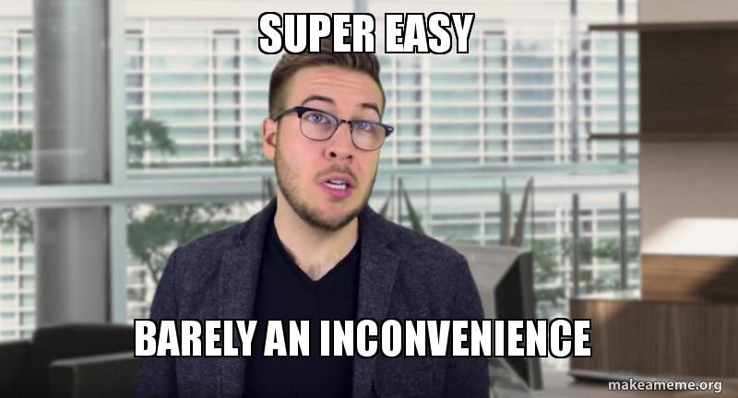
So, How Do We Legally Agree to Defer to Code?

Slide 39
Default Rule – Defer to Code
Smart Contract Results Binding. “With respect to the Subject Property, except as set forth in Section 2, the results of operation of the Smart Contract shall be determinative of the rights and obligations of, and shall be final, binding upon and non-appealable by, each of the Parties.”

Slide 40
Default Rule – Defer to Code
PROBLEM :
WHAT HAPPENS IF Party a sues party b TO CONTEST RESULTS OF THE CODE?

Slide 41
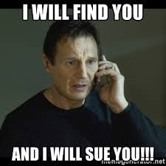

Default Rule – Defer to Code

Slide 42
CONTRACTUALLY PROHIBIT LAWSUITS
SOLUTION :
ANTI-SUE CLAUSE

Slide 43
Default Rule – No Lawsuits
“Prohibition of Legal Proceedings. Except as set forth in Section 2, each Party shall not directly or indirectly commence or continue any Legal Proceeding, assert any Claim or enforce any judgment or other Order, or attempt or seek to do any of the foregoing, in each case, against or involving the other Party or relating to this Agreement, the Designated Smart Contract, the Subject Property or any of the other subject matter of or matters contemplated by this Agreement.”

Slide 44
Default Rule – Defer to Code
PROBLEM :
WHAT happens if the smart contract has bugs, is hacked, etc.?

Slide 45
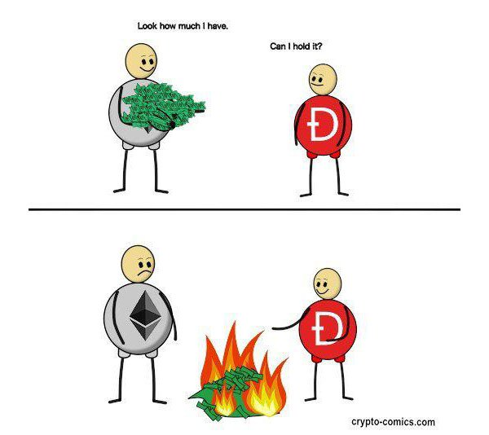
Default Rule – Defer to Code – Problems
June 18, 2016 –
The TheDao Hack

Slide 46
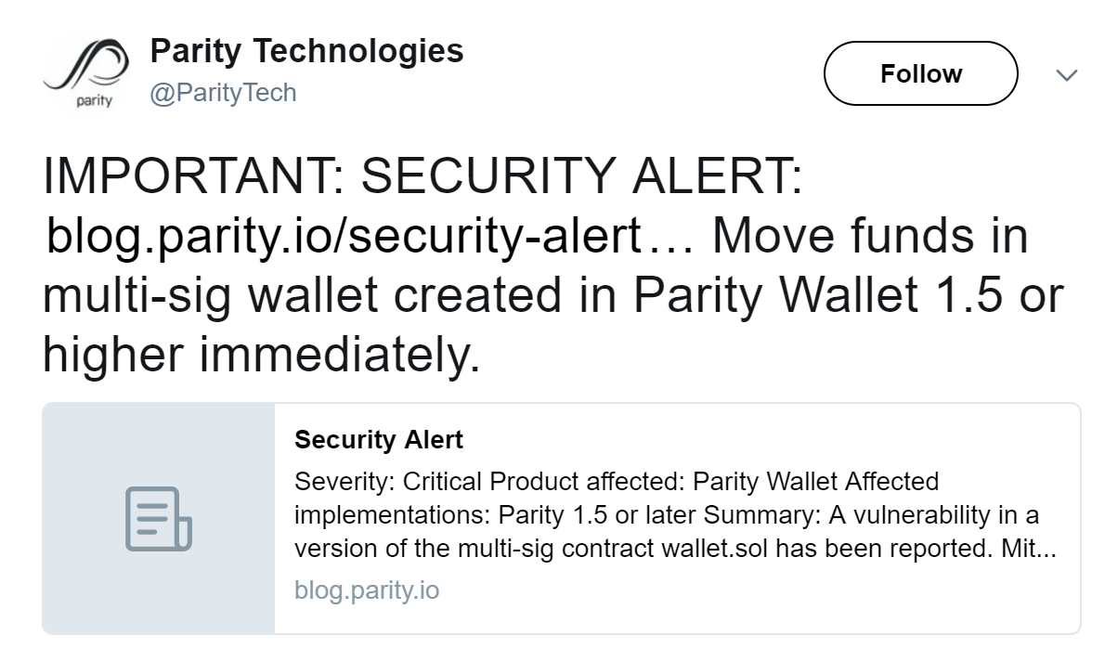
Default Rule – Defer to Code - Problems
July 19, 2017 –
Parity Multisig Wallet Hack
“At around 12:19 pm UTC today, 153,037 ETH (30M USD) was stolen from Edgeless Casino, Aeternity, and Swarm City. The funds were stolen from these accounts by likely the same core of hackers that pulled of the infamous DAO hack. The Ethereum client Parity was exploited even though it had been touted as the safest method of interacting with the Ethereum network.”

Slide 47
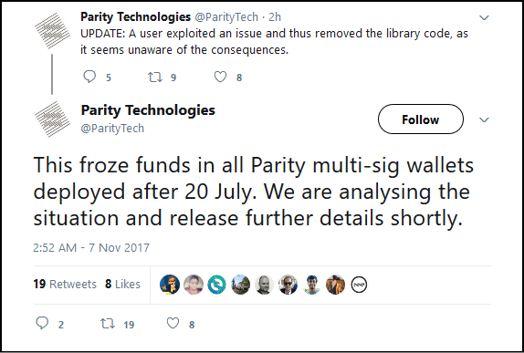
Default Rule – Defer to Code -Problems
November 7, 2017 –
Parity Multisig Wallet Self-Destruct

Slide 48
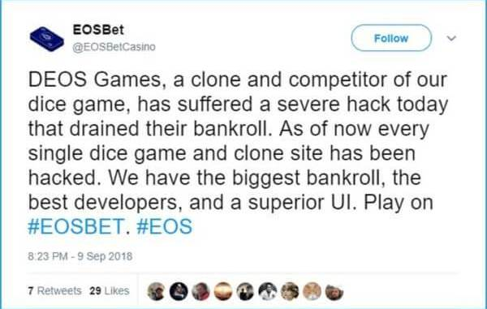
Default Rule – Defer to Code -Problems

Slide 49
EXCEPTION HANDLING THROUGH ARBITRATION
SOLUTION :
ARBITRATION

Slide 50
How to Handle Hacks/Thefts, Bugs, Forks?
Step 1 – Notice Covenant
“If either Party becomes aware that there is or would reasonably be expected to occur a Material Adverse Exception Event, such Party shall deliver to the other Party a notice thereof signed by such Party.”
Good idea: make the statements in the notice reps/warranties (legally actionable if inaccurate) to avoid nuisance attacks.

Slide 51
How to Handle Hacks/Thefts, Bugs, Forks?
Step 2 – Standstill
“Each Party shall: (A) safeguard and, except as set forth in the following clause “(B),” refrain from spending, transferring, encumbering converting or otherwise using any Tokens that may have been Transferred to such Party as a result of the Material Adverse Exception Event; and (B) deposit and maintain such Tokens in a segregated Account Address to be treated, to the extent permitted by applicable Legal Requirements, as a custodial trust held for the benefit of the other Party.”

Slide 52
How to Handle Hacks/Thefts, Bugs, Forks?
Step 3 – Confer & Negotiate
“The Parties shall use commercially reasonable efforts to negotiate in good faith to agree upon the existence or non-existence of a Material Adverse Exception Event and, if so agreed, the actions to be taken, the agreements to be entered into and the remedies to be sought by the Parties in response to the Material Adverse Exception Event.”

Slide 53
How to Handle Hacks/Thefts, Bugs, Forks?
Step 4 – Arbitrate
“If the Parties fail to reach an agreement resulting in an Exception Handling Addendum during the Negotiation Period, then either Party may initiate an arbitration action to resolve the issues in accordance with the Arbitration Procedures. The decision resulting from the Arbitration Procedures shall be non- appealable, binding and conclusive upon the Parties. Judgment upon such decision may be entered in any court of competent jurisdiction.”

Slide 54
How to Handle Hacks/Thefts, Bugs, Forks?
Reminder: what is a “Material Adverse Exception Event”?
Inspired by M&A “Material Adverse Effect” condition/walk-right
Basically defined as ‘the bad things that can happen with a smart contract for reasons other than the parties just being stupid/lazy’.

Slide 55
How to Handle Hacks/Thefts, Bugs, Forks?
Ex. - “Material Adverse Exception Event” means:
a Consensus Attack adversely affecting the results or operations of the Designated Smart Contract;
a Contentious Blockchain Fork;
the Designated Smart Contract having become inoperable, inaccessible or unusable through no error or omission by either of the Parties;
any unauthorized use of an administrative function or privilege of the Designated Smart Contract; or
the Designated Smart Contract[, any of the Parties] or the Subject Property becoming subject to a Legal Order that prohibits the Designated Smart Contract [(or that, if the Designated Smart Contract were a Person, would prohibit the Designated Smart Contract)] from executing any function or operation it would otherwise reasonably be expected to execute.”

Slide 56
Objections & Answers

Slide 57
O & A
Obj: “smart contracting [is] more expensive and less efficient than traditional semantic contracts in environments when there is ex post uncertainty, or where parties prefer to avoid drafting highly customized agreements” (Sklaroff)
A: True, but:
Qualified code deference allows the benefits of flexibility in edge cases, lowering marginal ex ante burden
Smart contracts may nevertheless be appropriate for contracts that are only varied based on collective action and in extraordinary circumstances.
Example: a Certificate of Incorporation

Slide 58
O & A
Obj: “smart contract is a misleading term because smart contracts are neither smart nor contracts”
A: True, but:
the term has become extremely common; path dependence—too late to change
nothing with more accuracy but equal or greater memeness has been offered up
persistent code + QCD wrapper = “smart contract” in a way more deserving of the term

Slide 59
O & A
Obj: “smart contract are an example of autonomous software, and autonomous software is bad because it may do harm”
A: True, but:
inability to stop a smart contract on-chain does not entail lack of a legal remedy off-chain
lawyers + programmers + experience may prove to be much better at avoiding major problems than some would currently think
ex: cars are much safer today, and likely will get safer due to autonomous operation rather than more dangerous
it is at least possible that net social benefits from trust reduction, access to justice > net social costs from downsides to autonomous contracts
QCD mitigates many of the dangers

Slide 60
Sources
On the Intersection of Ricardian and Smart Contracts, Ian Grigg, February 2015 http://iang.org/papers/intersection_ricardian_smart.html
Formalizing and Securing Relationships on Public Networks, Nick Szabo, 1997 https://nakamotoinstitute.org/formalizing-securing-relationships/
Smart Contracts and the Cost of Inflexibility, Jeremy M. Sklaroff, September 18, 2017 https://papers.ssrn.com/sol3/papers.cfm?abstract_id=3008899

